Slide 1
Benzene Concentration Prediction in Air-Quality Dataset
Group 14
Ryley Benavides
David Shamis
Noah Daniels
Pranik Pant
Dhruv Savla

Slide 2
Problem Statement and Introduction to Dataset
Benzene is a carcinogenic pollutant that is measured in this dataset, and its concentration is to be predicted using a regression model based on other variables.
The dataset contains hourly averaged responses from an array of 5 metal oxide chemical sensors, embedded in an Air Quality Chemical Multi Sensor Device, located in a polluted area in an Italian city. The data were recorded from March 2004 to February 2005, representing the longest freely available recordings of on-field deployed air quality chemical sensor devices responses.
Ground truth hourly averaged concentrations for CO, Non Metanic Hydrocarbons, Benzene, Total Nitrogen Oxides (NOx), and Nitrogen Dioxide (NO2) were provided by a co-located reference certified analyzer. These data points can be used to train and validate the regression model.
Notes:
This dataset contains measurements of benzene, a carcinogenic contaminant, and its concentration is to be predicted using a regression model based on other characteristics.
The dataset contains hourly averaged answers from a cluster of five metal oxide chemical sensors installed in an Air Quality Chemical Multi Sensor Device in a polluted part of an Italian city. The data were collected between March 2004 and February 2005, making it the longest free recording of on-field deployed air quality chemical sensor device responses.
A co-located reference certified analyzer supplied ground truth hourly averaged readings for CO, Non Metanic Hydrocarbons, Benzene, Total Nitrogen Oxides (NOx), and Nitrogen Dioxide (NO2). The regression model can be trained and validated using these data points.

Slide 3
Understanding the Data
The dataset presents evidences of cross-sensitivities, concept, and sensor drifts that could affect the sensor's estimation capabilities. These factors need to be taken into account while training the regression model.
Missing values in the dataset are tagged with a value of -200. Appropriate preprocessing steps need to be taken to handle these missing values before training the regression model.
By training a regression model on this dataset, it is possible to predict Benzene concentration levels, which can help in monitoring air quality and taking appropriate measures to reduce pollution levels.
Notes:
The dataset contains indications of cross-sensitivities, concept drifts, and sensor drifts, all of which could impair the sensor's estimate capabilities. These factors must be considered when training the regression model.
Missing values in the dataset are labeled with -200. Before training the regression model, appropriate preprocessing steps must be taken to handle these missing values.
It is feasible to forecast Benzene concentration levels by training a regression model on this information, which can aid in monitoring air quality and applying suitable pollution-reduction measures.

Slide 4
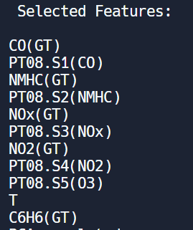
EDA and Feature Selection
Drop -200 values
Drop “Date” and “Time”
Use z scores to define outliers and leave them out
Perform data cleaning
Feature selection with SelectKBest algorithm
Notes:
*** add domain knowledge for picking K

Slide 5
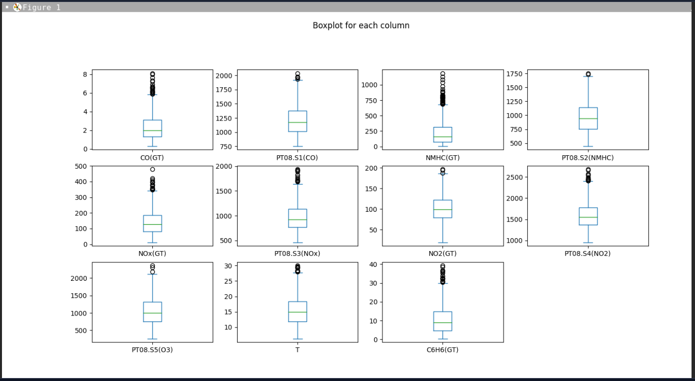
Visualization: Box Plot
Notes:
df_selected.plot(kind='box', subplots=True, layout=(4,4), figsize=(15,10), title='Boxplot for each column')
Shows the data distribution for the variables in the dataset

Slide 6
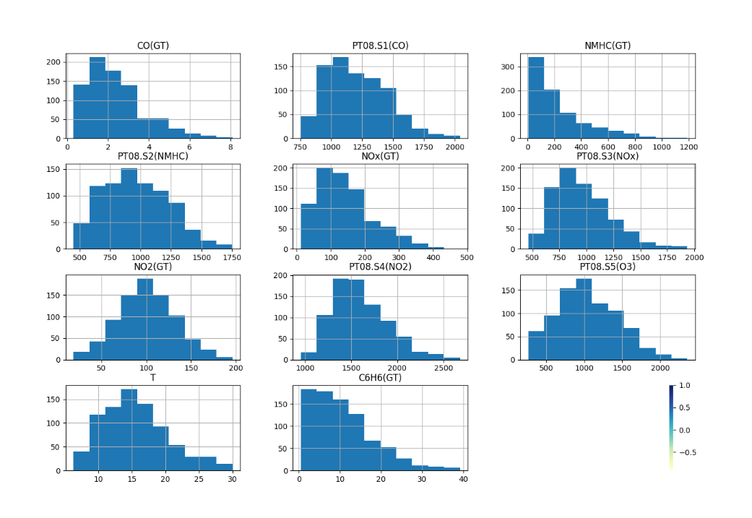
Visualization: Histogram
Notes:
Shows the frequency distribution for the variables in the dataset

Slide 7
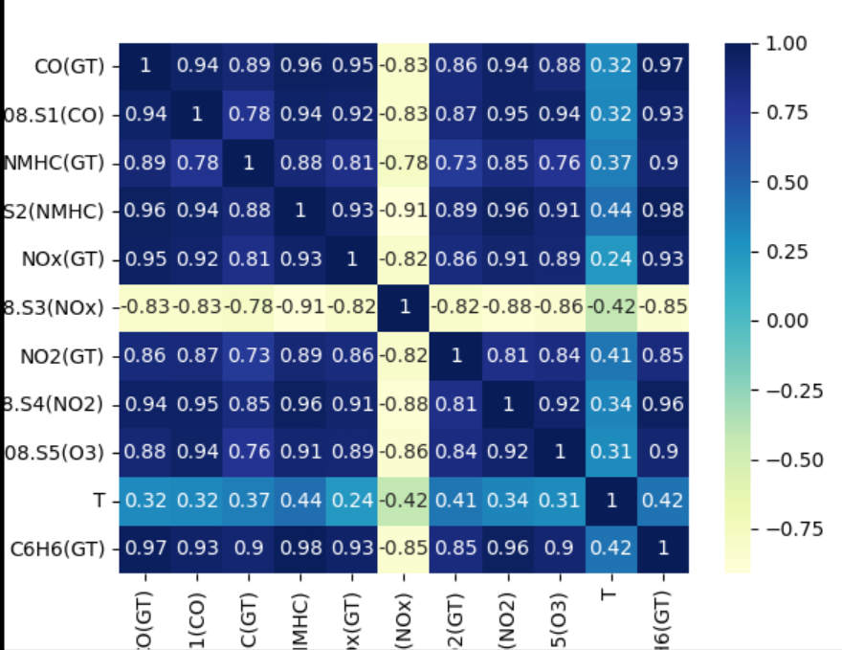
Visualization: Correlation Matrix
Notes:
A correlation matrix tells us about the strength and direction of the relationship between pairs of variables in a dataset.
The diagonal of the matrix always shows a perfect correlation (a variable is perfectly correlated with itself). The upper and lower triangles of the matrix show the same information, so typically, only one triangle is shown.
A correlation matrix can help us to identify variables that are highly correlated with each other, which can be problematic for some statistical models. High correlation between variables can lead to multicollinearity, which can cause instability in the model and make it difficult to interpret the coefficients. Additionally, a correlation matrix can help us to identify relationships between variables that may be useful for predictive modeling.

Slide 8
PCA
Dimension Reduction for the amount of variables
Select all feature variables for PCA input and Benzene as the y variable for PCA plot
This helped filter out noise by focusing on the parameter that affect the concentrations of benzene more
This step was important to find underlying relationships of the data that impact benzene concentration that aren’t directly correlated

Slide 9
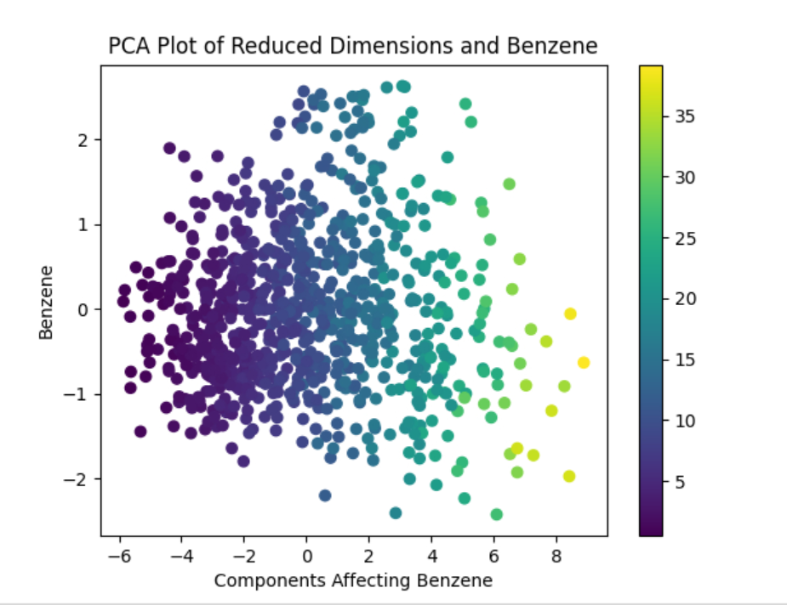
Plotting PCA
Notes:
We used 2 PC’s for the data visualization
A PCA plot (Principal Component Analysis plot) is a visual representation of the data after it has been transformed by PCA. It is a scatter plot that shows how the data points are distributed along the principal components. Each point in the plot represents an observation (or row) in the data, and its position in the plot is determined by the values of the first two principal components.
The PCA plot can tell us several things about the data:
It can reveal patterns or clusters in the data that may not be apparent in the original variables.
It can show how much of the variability in the data is explained by the principal components.
It can help identify outliers or extreme values in the data.
It can provide insights into which variables or features contribute most to the variability in the data.

Slide 10
Linear Regression Model:
from sklearn.linear_model import LinearRegression
from sklearn.model_selection import train_test_split
from sklearn.metrics import mean_squared_error
import pandas as pd
# Split data into train and test sets
X = data.drop('Benzene', axis=1)
y = data['Benzene']
X_train, X_test, y_train, y_test = train_test_split(X, y, test_size=0.2, random_state=42)
# Train a linear regression model
lr = LinearRegression()
lr.fit(X_train, y_train)
# Make predictions on test set
y_pred = lr.predict(X_test)
# Calculate mean squared error as evaluation metric
mse = mean_squared_error(y_test, y_pred)
print(f'Mean squared error: {mse:.2f}')
Linear regression assumes a linear relationship between the input variables (sensor responses) and output variable (Benzene concentration).
Linear regression models are relatively simple and easy to interpret, making them a popular choice for many regression problems.
Linear regression models can capture both the direction and magnitude of the relationship between the input and output variables.
Since Benzene concentration is a continuous variable, linear regression is an appropriate choice for modeling this type of data.
Linear regression may not capture non-linear relationships or interactions between the input variables, which can lead to inaccurate predictions in cases where such relationships exist.
Notes:
Linear regression presupposes that the input variables (sensor responses) and output variables (benzene concentration) have a linear relationship.
Linear regression models are popular for many regression situations because they are basic and easy to interpret.
Linear regression models can capture the magnitude as well as the direction of the connection between the input and output variables.
Because benzene concentration is a continuous variable, linear regression is a good fit for this type of data.
Linear regression may miss non-linear correlations or interactions between input variables, resulting in erroneous predictions in circumstances when such relationships exist.

Slide 11
Polynomial Regression Model:
Polynomial regression is a flexible and powerful modeling technique that can capture non-linear relationships between the input variables and output variable (Benzene concentration).
Polynomial regression models can capture more complex relationships between the input and output variables than linear regression models, making them more suitable for some datasets.
Polynomial regression models can be easily adjusted to fit different degrees of non-linearity in the data.
Since Benzene concentration is a continuous variable, polynomial regression is an appropriate choice for modeling this type of data.
Polynomial regression models can be prone to overfitting, where the model fits the noise in the data instead of the underlying relationships, leading to poor generalization performance on new data. It is important to use techniques such as cross-validation and regularization to prevent overfitting in polynomial regression models.
from sklearn.linear_model import LinearRegression
from sklearn.preprocessing import PolynomialFeatures
# Reshape the data to a column vector
x = x.reshape(-1, 1)
# Create a polynomial features object with degree 2
poly = PolynomialFeatures(degree=2)
# Transform the input data to include polynomial features
x_poly = poly.fit_transform(x)
# Fit a linear regression model to the transformed data
model = LinearRegression()
model.fit(x_poly, y)
# Evaluate the model on some new data
x_new = np.linspace(-15, 15, num=100).reshape(-1, 1)
x_new_poly = poly.transform(x_new)
y_new = model.predict(x_new_poly)
# Plot the original data and the model predictions
plt.scatter(x, y)
plt.plot(x_new, y_new, color='red')
plt.show()
Notes:
Polynomial regression is a versatile and powerful modeling technique capable of capturing nonlinear correlations between input factors and output variables (Benzene concentration).
Polynomial regression models are more capable of capturing complex relationships between input and output variables than linear regression models, making them more appropriate for specific datasets.
Polynomial regression models can be simply changed to suit data with varying degrees of nonlinearity.
Polynomial regression is an excellent choice for modeling this type of data because benzene concentration is a continuous variable.
Polynomial regression models are prone to overfitting, which occurs when the model fits the data noise rather than the underlying relationships, resulting in poor generalization performance on new data. To avoid overfitting in polynomial regression models, procedures such as cross-validation and regularization should be used.
Better than linear

Slide 12
Lasso Regression Model:
Lasso regression is a type of linear regression that can perform feature selection, which can help to reduce the complexity of the model and improve its interpretability.
Lasso regression can be used to identify the most important variables for predicting Benzene concentration and exclude those that are less important, leading to a more parsimonious model.
Lasso regression is effective at handling datasets with high-dimensional input spaces, where there are many input variables that may be irrelevant or redundant for predicting the output variable.
Lasso regression can be used to perform regularization, which can help to prevent overfitting and improve the generalization performance of the model on new data.
Lasso regression can be sensitive to the scaling of the input variables, so it is important to normalize the data before training the model. In addition, the regularization parameter needs to be carefully tuned to balance the trade-off between model complexity and performance.
from keras.models import Sequential
from keras.layers import Dense
from keras.regularizers import l1
# create a sequential model
model = Sequential()
# add a dense layer with L1 regularization and 10 units
model.add(Dense(10, input_shape=(X_train.shape[1],),
activation='relu', kernel_regularizer=l1(0.001)))
# add an output layer with one unit
model.add(Dense(1, activation='linear'))
# compile the model
model.compile(loss='mean_squared_error', optimizer='adam')
# train the model
model.fit(X_train, y_train, epochs=100, batch_size=32, verbose=0)
Notes:
Lasso regression is a sort of linear regression that uses feature selection to minimize model complexity and increase model interpretability.
Lasso regression can be used to find the most essential factors for predicting Benzene concentration and exclude the less important ones, resulting in a more parsimonious model.
Lasso regression works well with datasets with high-dimensional input spaces, where many input variables may be useless or redundant for predicting the output variable.
Lasso regression is a variant of linear regression that includes a regularization term in the loss function, which helps to prevent overfitting and can improve the generalization performance of the model. The Lasso regression model shrinks the coefficients of less important features to zero, effectively performing feature selection.
Better than linear

Slide 13
Bayes Regression Model:
Bayesian regression uses Bayes' theorem to update the prior probability of the model parameters based on the observed data and the likelihood function.
Bayesian regression allows for the incorporation of prior knowledge or beliefs about the model parameters, which can improve the accuracy of the predictions.
Bayesian regression can handle small sample sizes and missing data more effectively than traditional regression methods.
In Bayesian regression, the posterior distribution of the model parameters can be used to estimate the uncertainty in the predictions
# specify the response variable
response_var = 'C6H6(GT)'
# create the feature matrix and response vector
X = df.drop(response_var, axis=1)
y = df[response_var]
# create the Gaussian Naive Bayes model
nb = GaussianNB()
# fit the model to the data
nb.fit(X, y)
Notes:
Bayesian regression updates the prior probability of model parameters depending on observed data and the likelihood function using Bayes' theorem.
Bayesian regression permits the insertion of previous knowledge or beliefs about model parameters, which can increase prediction accuracy.
Bayesian regression is more effective than traditional regression approaches in dealing with small sample sizes and missing data.
The posterior distribution of the model parameters can be used to quantify the uncertainty in the predictions in Bayesian regression.

Slide 14
SVM Regression Model:
from sklearn.svm import SVR
from keras.models import Sequential
from keras.layers import Dense
# create an SVM regressor
svr = SVR(kernel='linear', C=1.0, epsilon=0.1)
# fit the regressor to the training data
svr.fit(X_train, y_train)
# create a sequential model
model = Sequential()
# add a dense layer with one unit and no activation function
model.add(Dense(1, input_shape=(X_train.shape[1],), activation=None))
# compile the model with the hinge loss function and the SVM regressor as the optimizer
model.compile(loss='hinge', optimizer=svr)
# evaluate the model on the testing data
score = model.evaluate(X_test, y_test)
SVM is a powerful machine learning algorithm that can effectively handle high-dimensional datasets and nonlinear relationships between input variables and output variables.
SVM can perform both linear and nonlinear regression, making it suitable for datasets with complex relationships.
SVM can effectively handle outliers and noisy data, making it robust to data imperfections.
SVM can be used to perform feature selection, which can help to identify the most important variables for predicting Benzene concentration and exclude those that are less important, leading to a more interpretable model.
SVM models can be computationally expensive to train and tune, especially for large datasets or datasets with a large number of input variables. In addition, SVM models can be sensitive to the choice of hyperparameters, such as the kernel function and regularization parameter, which can require a considerable amount of experimentation to optimize.
Notes:
SVM is a strong machine learning technique that can handle large datasets and nonlinear correlations between input and output variables.
SVM can do both linear and nonlinear regression, making it suited for complicated datasets.
SVM can handle outliers and noisy data successfully, making it resistant to data defects.
SVM can be used for feature selection, which can aid in identifying the most essential factors for predicting Benzene concentration and excluding those that aren't, resulting in a more interpretable model.
Training and tuning SVM models can be computationally expensive, especially for large datasets or datasets with a large number of input variables. Furthermore, SVM models can be sensitive to hyperparameter selection, such as the kernel function and regularization parameter, which can necessitate a significant amount of experimentation to optimize.

Slide 15
K-Fold Cross Validation
k = 5
num_validation_samples = len(reducedDimensionsPlot) // k
np.random.shuffle(reducedDimensionsPlot)
validation_scores = []
for fold in range(k):
validation_data = reducedDimensionsPlot[num_validation_samples * fold: num_validation_samples * (fold + 1)]
training_data = reducedDimensionsPlot[:num_validation_samples * fold] + reducedDimensionsPlot[num_validation_samples * (fold + 1):]
model = svm()
model.train(training_data)
validation_score = model.evaluate(validation_data)
validation_scores.append(validation_score)
validation_score = np.average(validation_scores)
k-fold cross-validation can help to evaluate the generalization performance of the regression models, by estimating how well they perform on new, unseen data.
k-fold cross-validation can help to prevent overfitting by detecting models that perform well on the training data but poorly on the test data, which is a sign of overfitting.
k-fold cross-validation can be computationally expensive, especially for large datasets or datasets with a large number of input variables, because it requires training and testing multiple models.
k-fold cross-validation can help to compare the performance of different regression models on the same dataset, which can provide insights into which models are more suitable for predicting Benzene concentration.
k-fold cross-validation can help to identify the hyperparameters of the regression models that lead to the best performance, by performing a grid search over a range of hyperparameters and selecting those that lead to the best cross-validation performance.
Notes:
By evaluating how well the regression models perform on new, unseen data, k-fold cross-validation can help to evaluate their generalization performance.
By finding models that perform well on the training data but badly on the test data, k-fold cross-validation can help to prevent overfitting.
Because it requires training and testing multiple models, k-fold cross-validation can be computationally expensive, especially for large datasets or datasets with a large number of input variables.
k-fold cross-validation can aid in comparing the performance of several regression models on the same dataset, revealing which models are better suited for forecasting Benzene concentration.
By doing a grid search over a variety of hyperparameters and selecting those that contribute to the highest cross-validation performance, k-fold cross-validation can assist in identifying the regression model hyperparameters that lead to the best performance.

Slide 16
Hyperparameter Tuning
Grid search is the best case for our models w/ low hyperparameter count
Lasso regression
Linear regression
Polynomial regression
Bayes regression
SVM regression
K-fold cross validation was used to test performance
Hyperparameter conclusion (alpha, lambda, intercept, etc.)
Notes:
The goal of hyperparameter tuning is to find the set of hyperparameters that results in the best performance of the model on the given dataset, while avoiding overfitting to the training data.
Grid Search: This involves exhaustively searching over a range of hyperparameters to find the best performing combination
For SVM: Kernel: The choice of kernel function to use. Popular options include linear, polynomial, radial basis function (RBF), and sigmoid.
C: The regularization parameter, which balances the trade-off between achieving a low training error and a low testing error. A smaller value of C will result in a wider margin and more regularization, while a larger value of C will result in a narrower margin and less regularization.
Gamma: A hyperparameter used only for kernels other than linear. It determines the influence of a single training example and can affect the smoothness of the decision boundary. A smaller value of gamma will result in a smoother decision boundary, while a larger value of gamma will result in a more complex decision boundary.
Degree: A hyperparameter used only for polynomial kernels, which specifies the degree of the polynomial.
Coef0: A hyperparameter used only for polynomial and sigmoid kernels, which controls the influence of the high-degree polynomials. A larger value of coef0 will result in a higher emphasis on high-degree polynomials.

Slide 17
Results and Conclusion
For this project we:
Performed data cleaning and dropped nonexistent values & outlier values
Did feature selection on a large dataset to make the model efficient
Plotted the correlation between the variables using box plots and histograms
Used PCA to do feature extraction
Chose 5 regression models and evaluated which model was the best
Did Hyperparameter tuning to optimize performance of the model
Performed a K-fold cross validation and determined the best model
SVM was the best regression model for our application because it can utilize kernels to classify higher-demensional feature spaces, and therefore can handle nonlinear data

